Slide 1

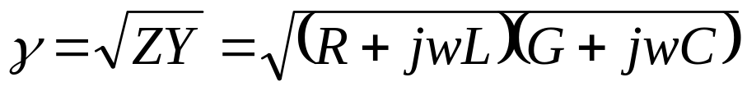
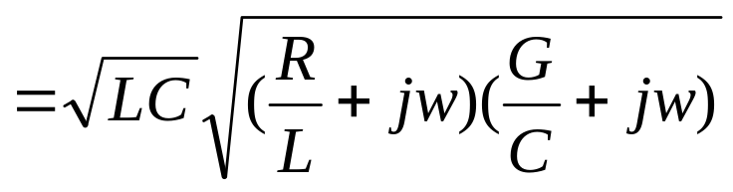

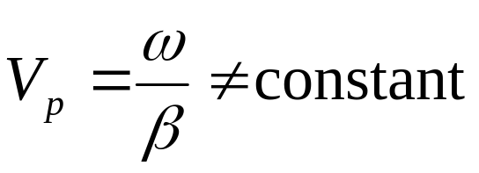
§2.6 Lossy Transmission Lines
Dispersion (a distortion, because phase velocities are different for different frequency components)

Slide 2
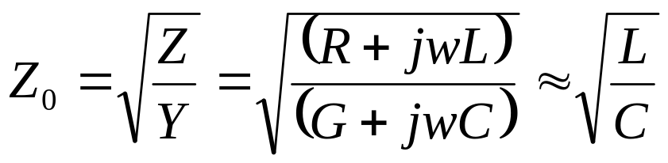

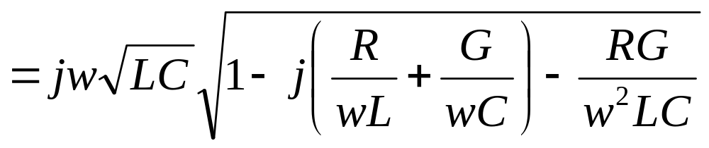

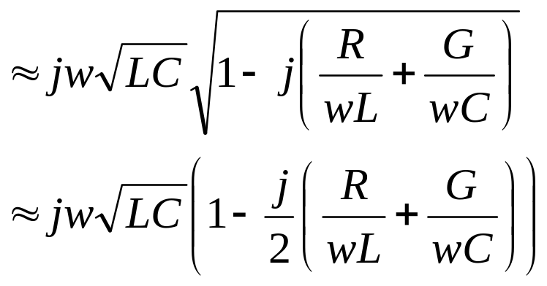
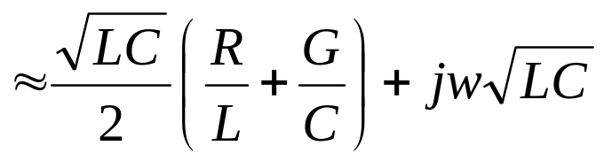
§2.6 Lossy Transmission Lines
(1) The low-loss Line

Slide 3
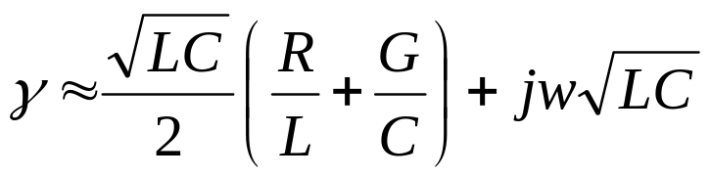
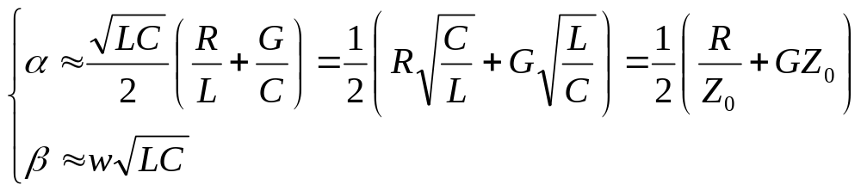
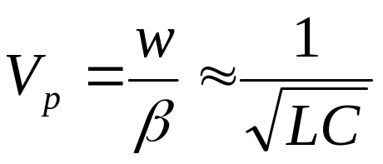
§2.6 Lossy Transmission Lines
Small dispersion

Slide 4
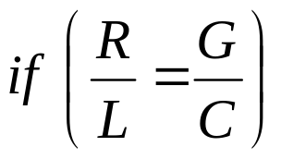
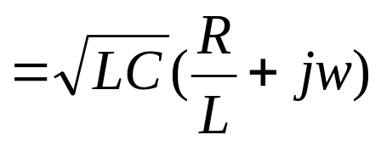
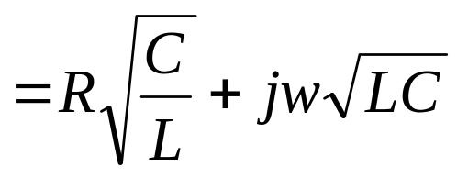
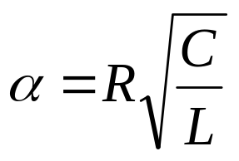
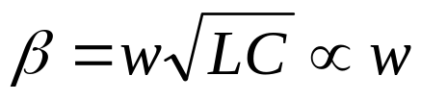

§2.6 Lossy Transmission Lines
(2) The Distortionless Line
not a function of frequency
No dispersion

Slide 5
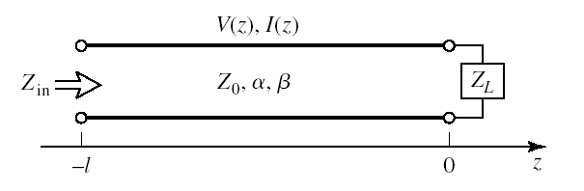
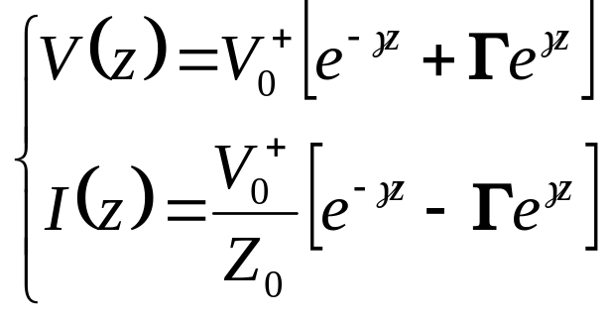

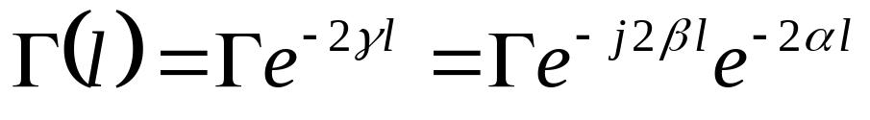
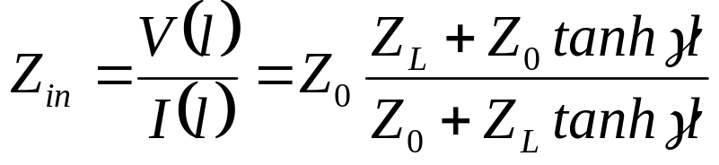
§2.6 Lossy Transmission Lines
(3) The Terminated Lossy Line

Slide 6
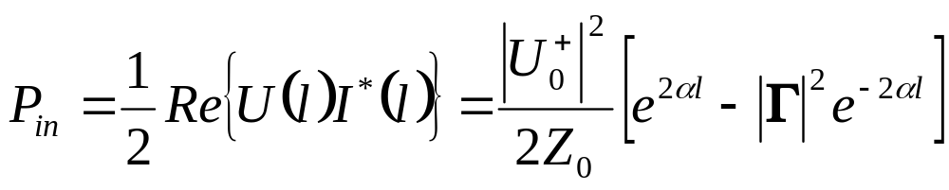
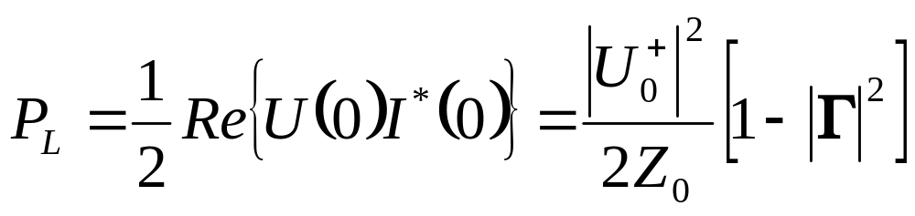
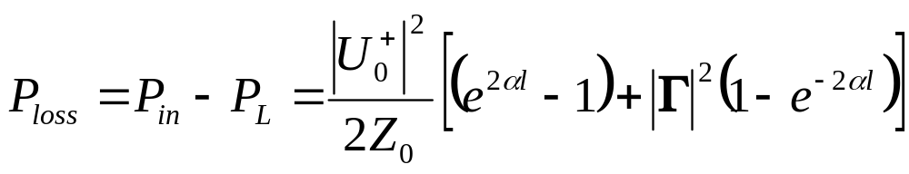
§2.6 Lossy Transmission Lines
Power lost in the line
Power loss of the incident wave
Power loss of the reflected wave

Slide 7
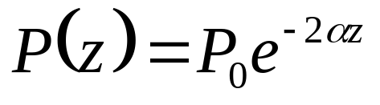
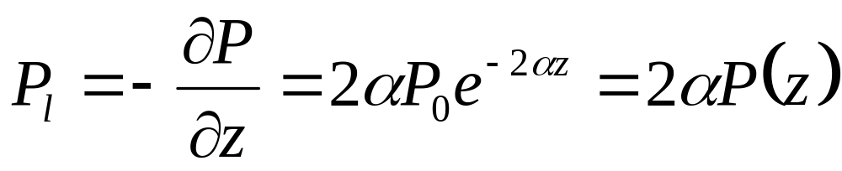
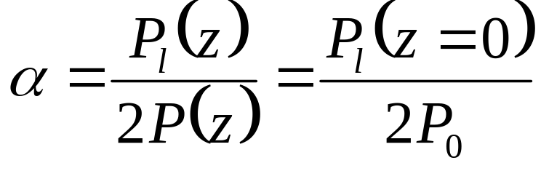
§2.6 Lossy Transmission Lines
(4) Perturbation Method for Calculating Attenuation Constant of a Low-Loss Line
Determine attenuation constant α, assumption that the fields of the lossy line are not greatly different from the fields of the lossless line
(When there is no reflection)
Define the power loss per unit length along the line as:
P_{l} can be computed from the fields of the lossless line, and can account for both conductor loss and dielectric loss

Slide 8
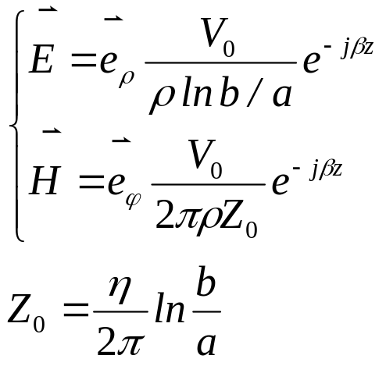
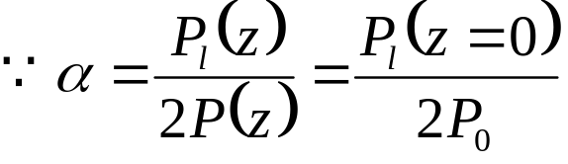
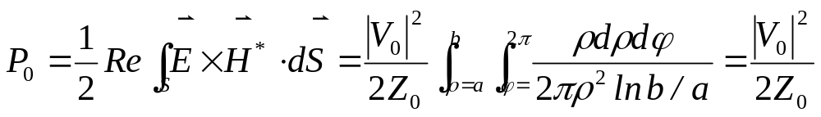
§2.6 Lossy Transmission Lines
Example: use the perturbation method to find the attenuation constant of a coaxial line having a lossy dielectric and lossy conductors
Fields of the lossless coaxial line for a<ρ<b:
The power flowing on the lossless lines

Slide 9
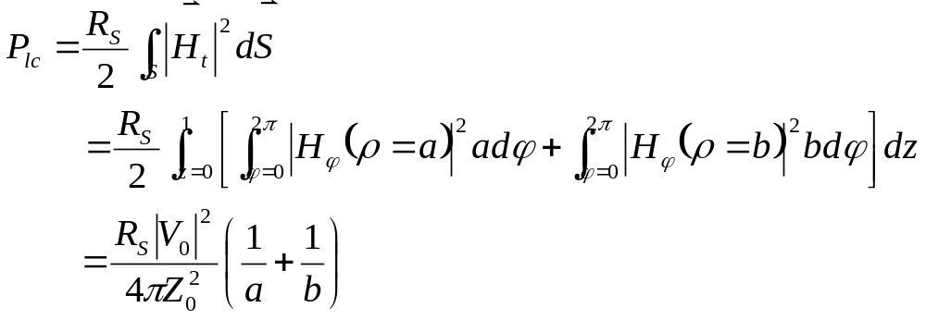
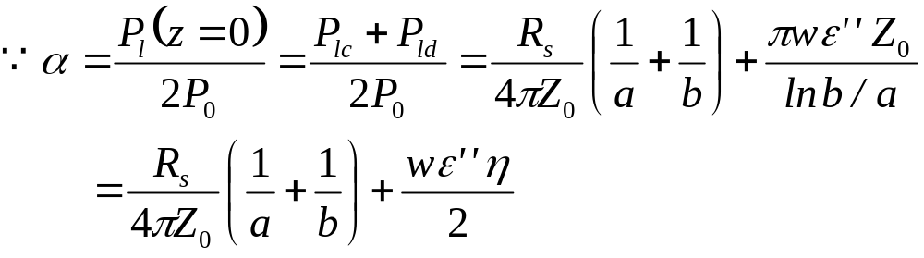

§2.6 Lossy Transmission Lines
The loss per unit length comes from conductor loss and dielectric loss

